Slide 1
Transfer Learning
Basma ElSaify
Microsoft

Slide 2
Artificial Intelligence
Rule Based System
Expert System
Machine Learning

Slide 3
Machine Learning
Arthur Samuel's definition from 1959:
Field of study that gives computers the ability to learn without being explicitly programmed.
Tom Mitchell’s definition from 1998:
A computer program is said to learn from experience E with respect to some task T and some performance measure P, if its performance on T, as measured by P, improves with experience E.
E (+) => T => P (+)
Experience [data], Task, Performance [Accuracy]

Slide 4
Deep Learning
Deep Learning is a method of statistical learning that extracts features or attributes from raw data. Deep Learning does this by utilizing neural networks with many hidden layers, big data, and powerful computational resources.

Slide 5
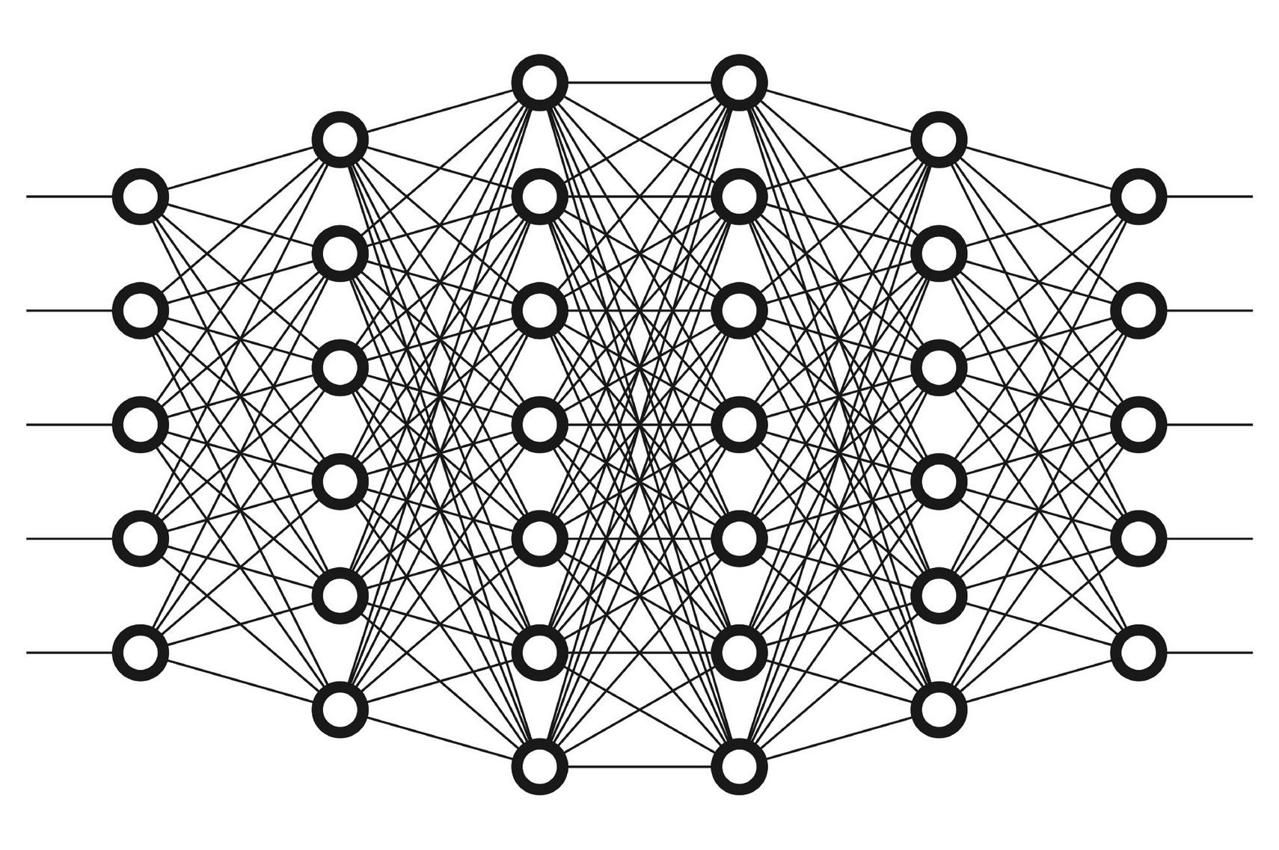
Deep Neural Network

Slide 6
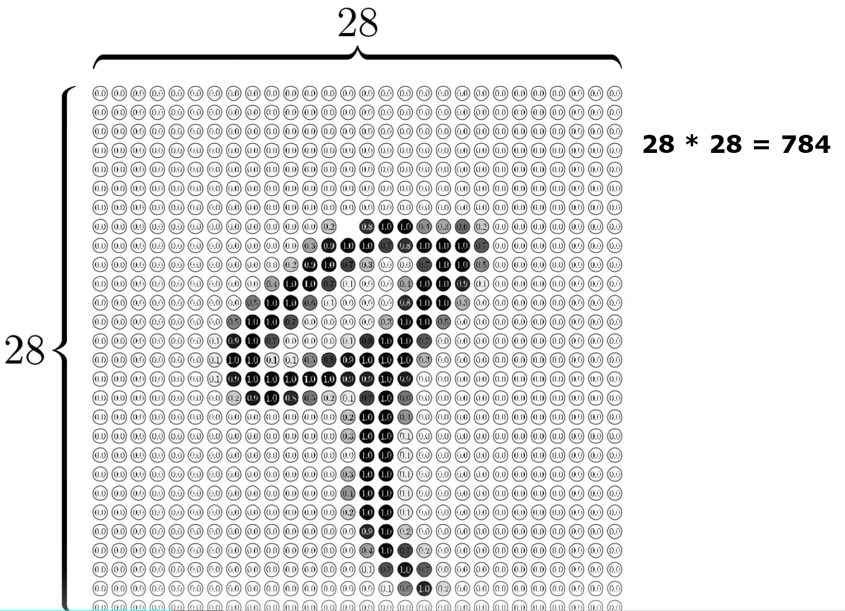
MNIST

Slide 7
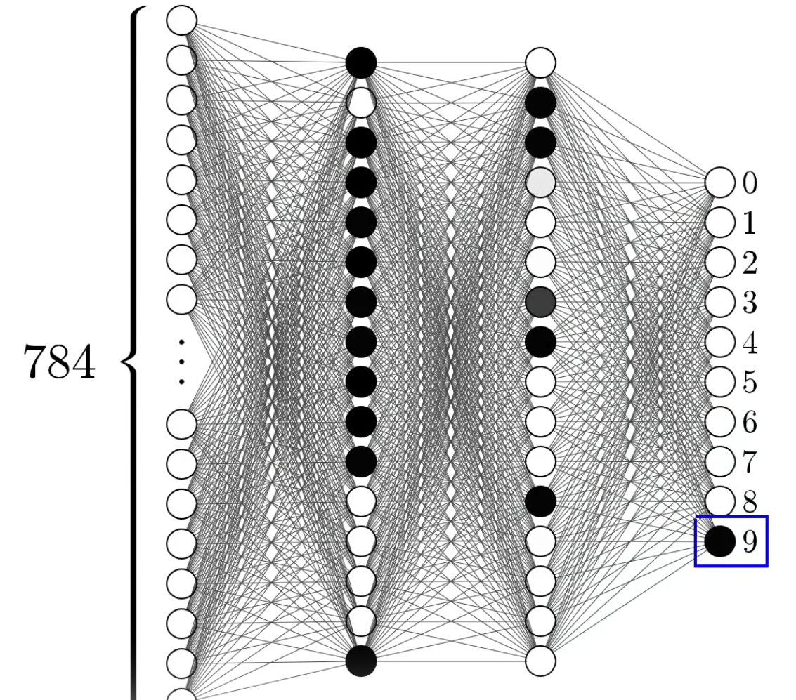
MNIST

Slide 8
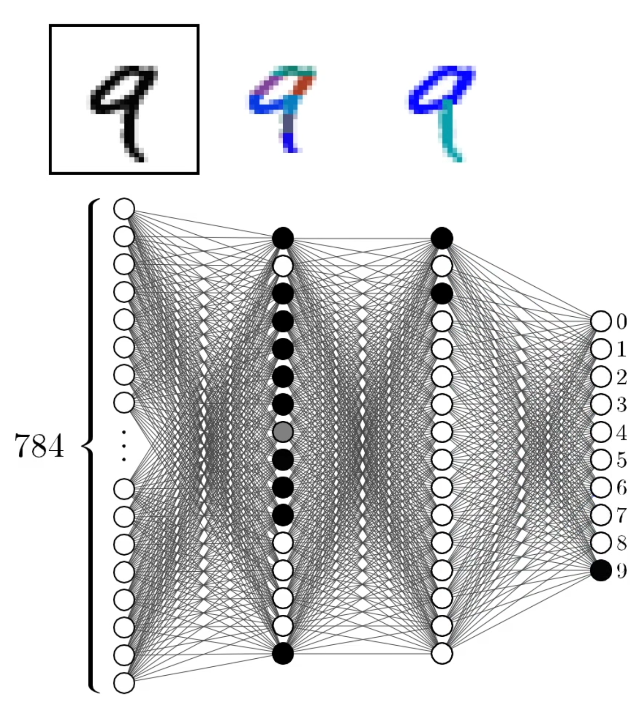
MNIST

Slide 9
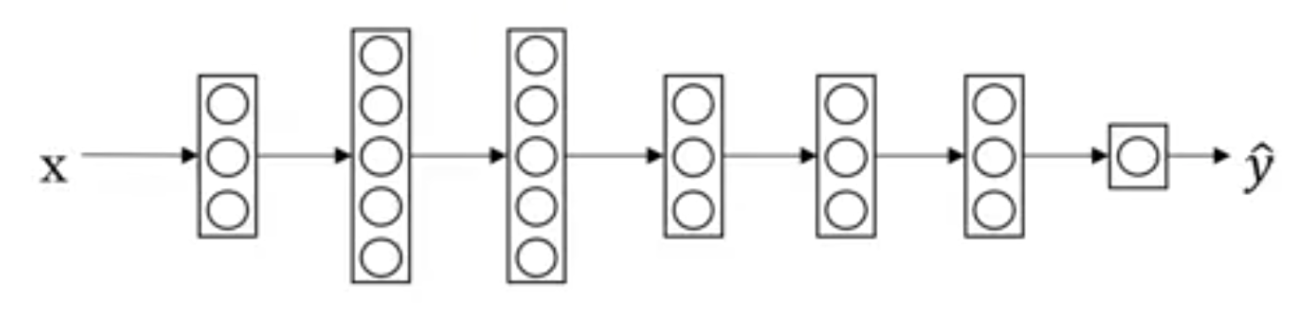
Transfer Learning
Object
Image Recognition
Images

Slide 10
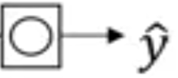
Transfer Learning
X
Object
Image Recognition
Images
1,000,000
radiology diagnosis
(x, y)
(Radiology Images, Diagnosis)
100

Slide 11
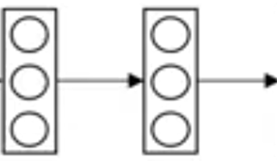
Transfer Learning
X
Object
Image Recognition
Images
1,000,000
radiology diagnosis
(x, y)
(Radiology Images, Diagnosis)
100

Slide 12
Transfer Learning
X
Object
Image Recognition
Images
1,000,000
Pre-Training
radiology diagnosis
(x, y)
(Radiology Images, Diagnosis)
100
Fine Tuning

Slide 13
Transfer Learning
X
Transcript
Speech Recognition
Audio
10,000h
Wake word/Trigger word
Detection
1h

Slide 14

When to use transfer learning
Transfer from a case with lots of data to relatively less data.
Low level features could be helpful.

Slide 16
References
https://www.youtube.com/watch?v=yofjFQddwHE

